Slide 1

PowerShell – An Auditors Best Friend
ISACA 2021 IT Security & Risk Symposium
November, 2021

Slide 2
Agenda
Speaker Introductions
Life of an Auditor
PowerShell the Tool
PowerShell the Gamechanger
Learning Resources
Questions

Slide 3

Speaker Introduction
Sunny Jamwal aka Sonny
Senior Manager Cybersecurity - MNP
Dalhousie University Alumni
Moved back to Halifax right before Covid
Obsessed with Russia’s cyber offense capabilities and Football (NFL)

Slide 4

Life of an Auditor
Never enough time
Scope creep
Gather relevant information in less time
Sampling is the Key
Trust but Verify

Slide 5
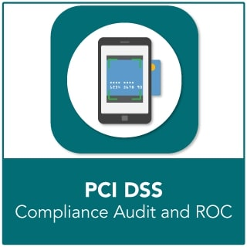
Life of an Auditor – Personal Story
>1000 Windows Servers
Spanned across two continents
10 Domain Controllers
Firewalls
WAF
Networking Devices etc. etc.

Slide 6
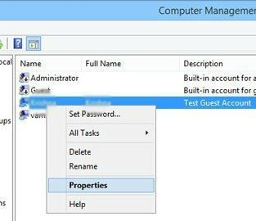
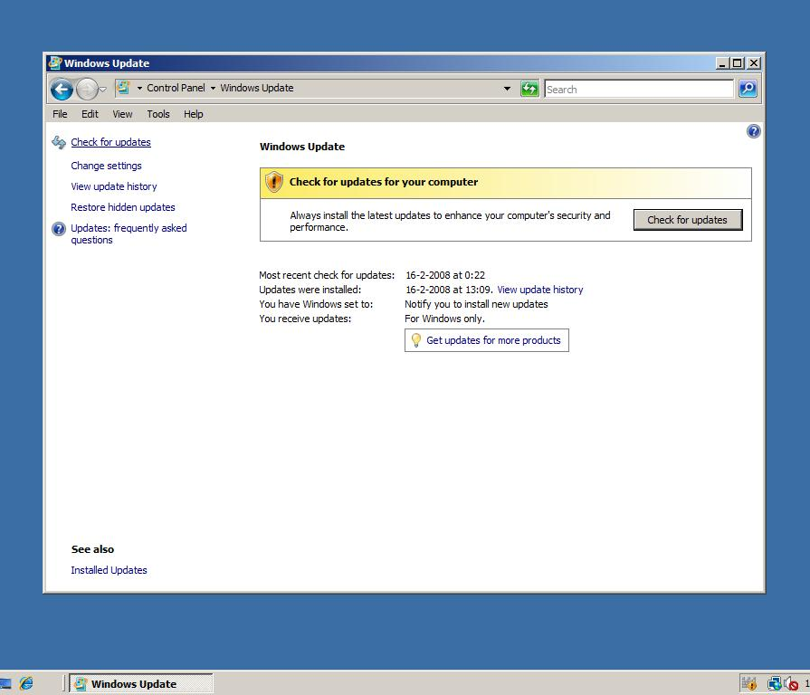
Life of an Auditor – Personal Story

Slide 7
Life of an Auditor
Inefficient
Time consuming
Labor intensive
Cause heavy drinking

Slide 8
Windows PowerShell
Windows PowerShell is a Windows command-line shell.
Windows PowerShell is built on top of the .NET Framework
Windows PowerShell introduces the concept of a cmdlet single-function command-line tool built into the shell
Windows PowerShell accepts and returns .NET Framework objects.
PowerShell makes it easier to interact with WIN 32 API.
You don’t need to be a programmer to harness the power of .NET Framework.

Slide 9
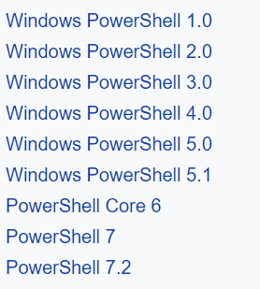

PowerShell

Slide 10
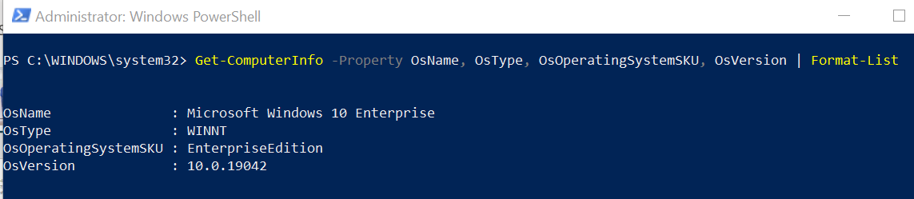
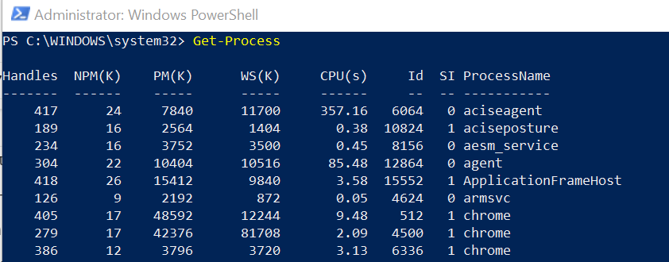
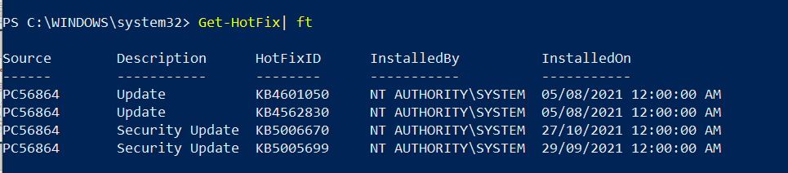
PowerShell the Tool

Slide 11
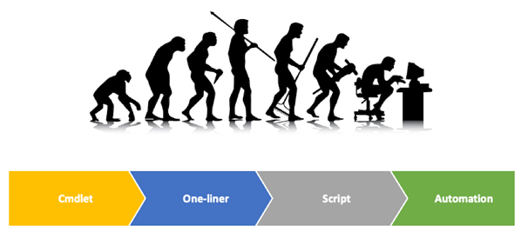
PowerShell the Tool

Slide 12
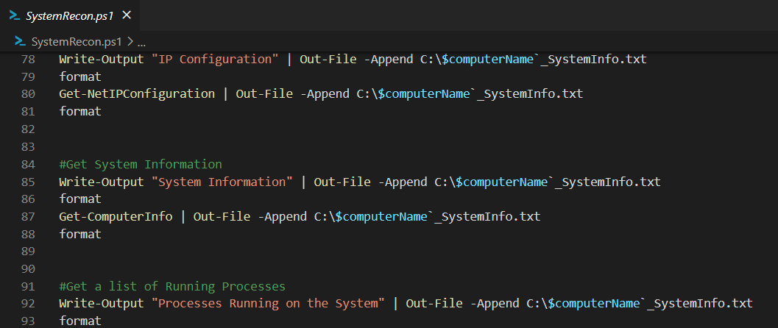
PowerShell the Tool

Slide 13
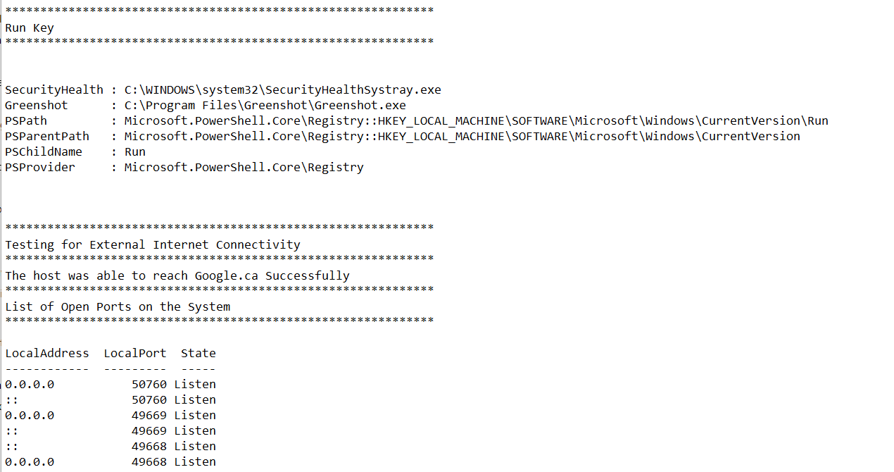
PowerShell the Tool

Slide 14
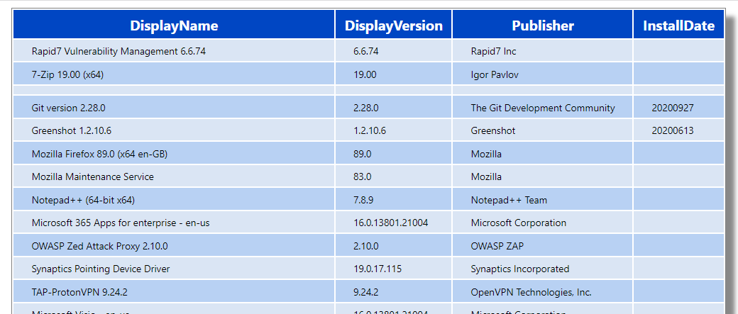
PowerShell the Tool

Slide 15
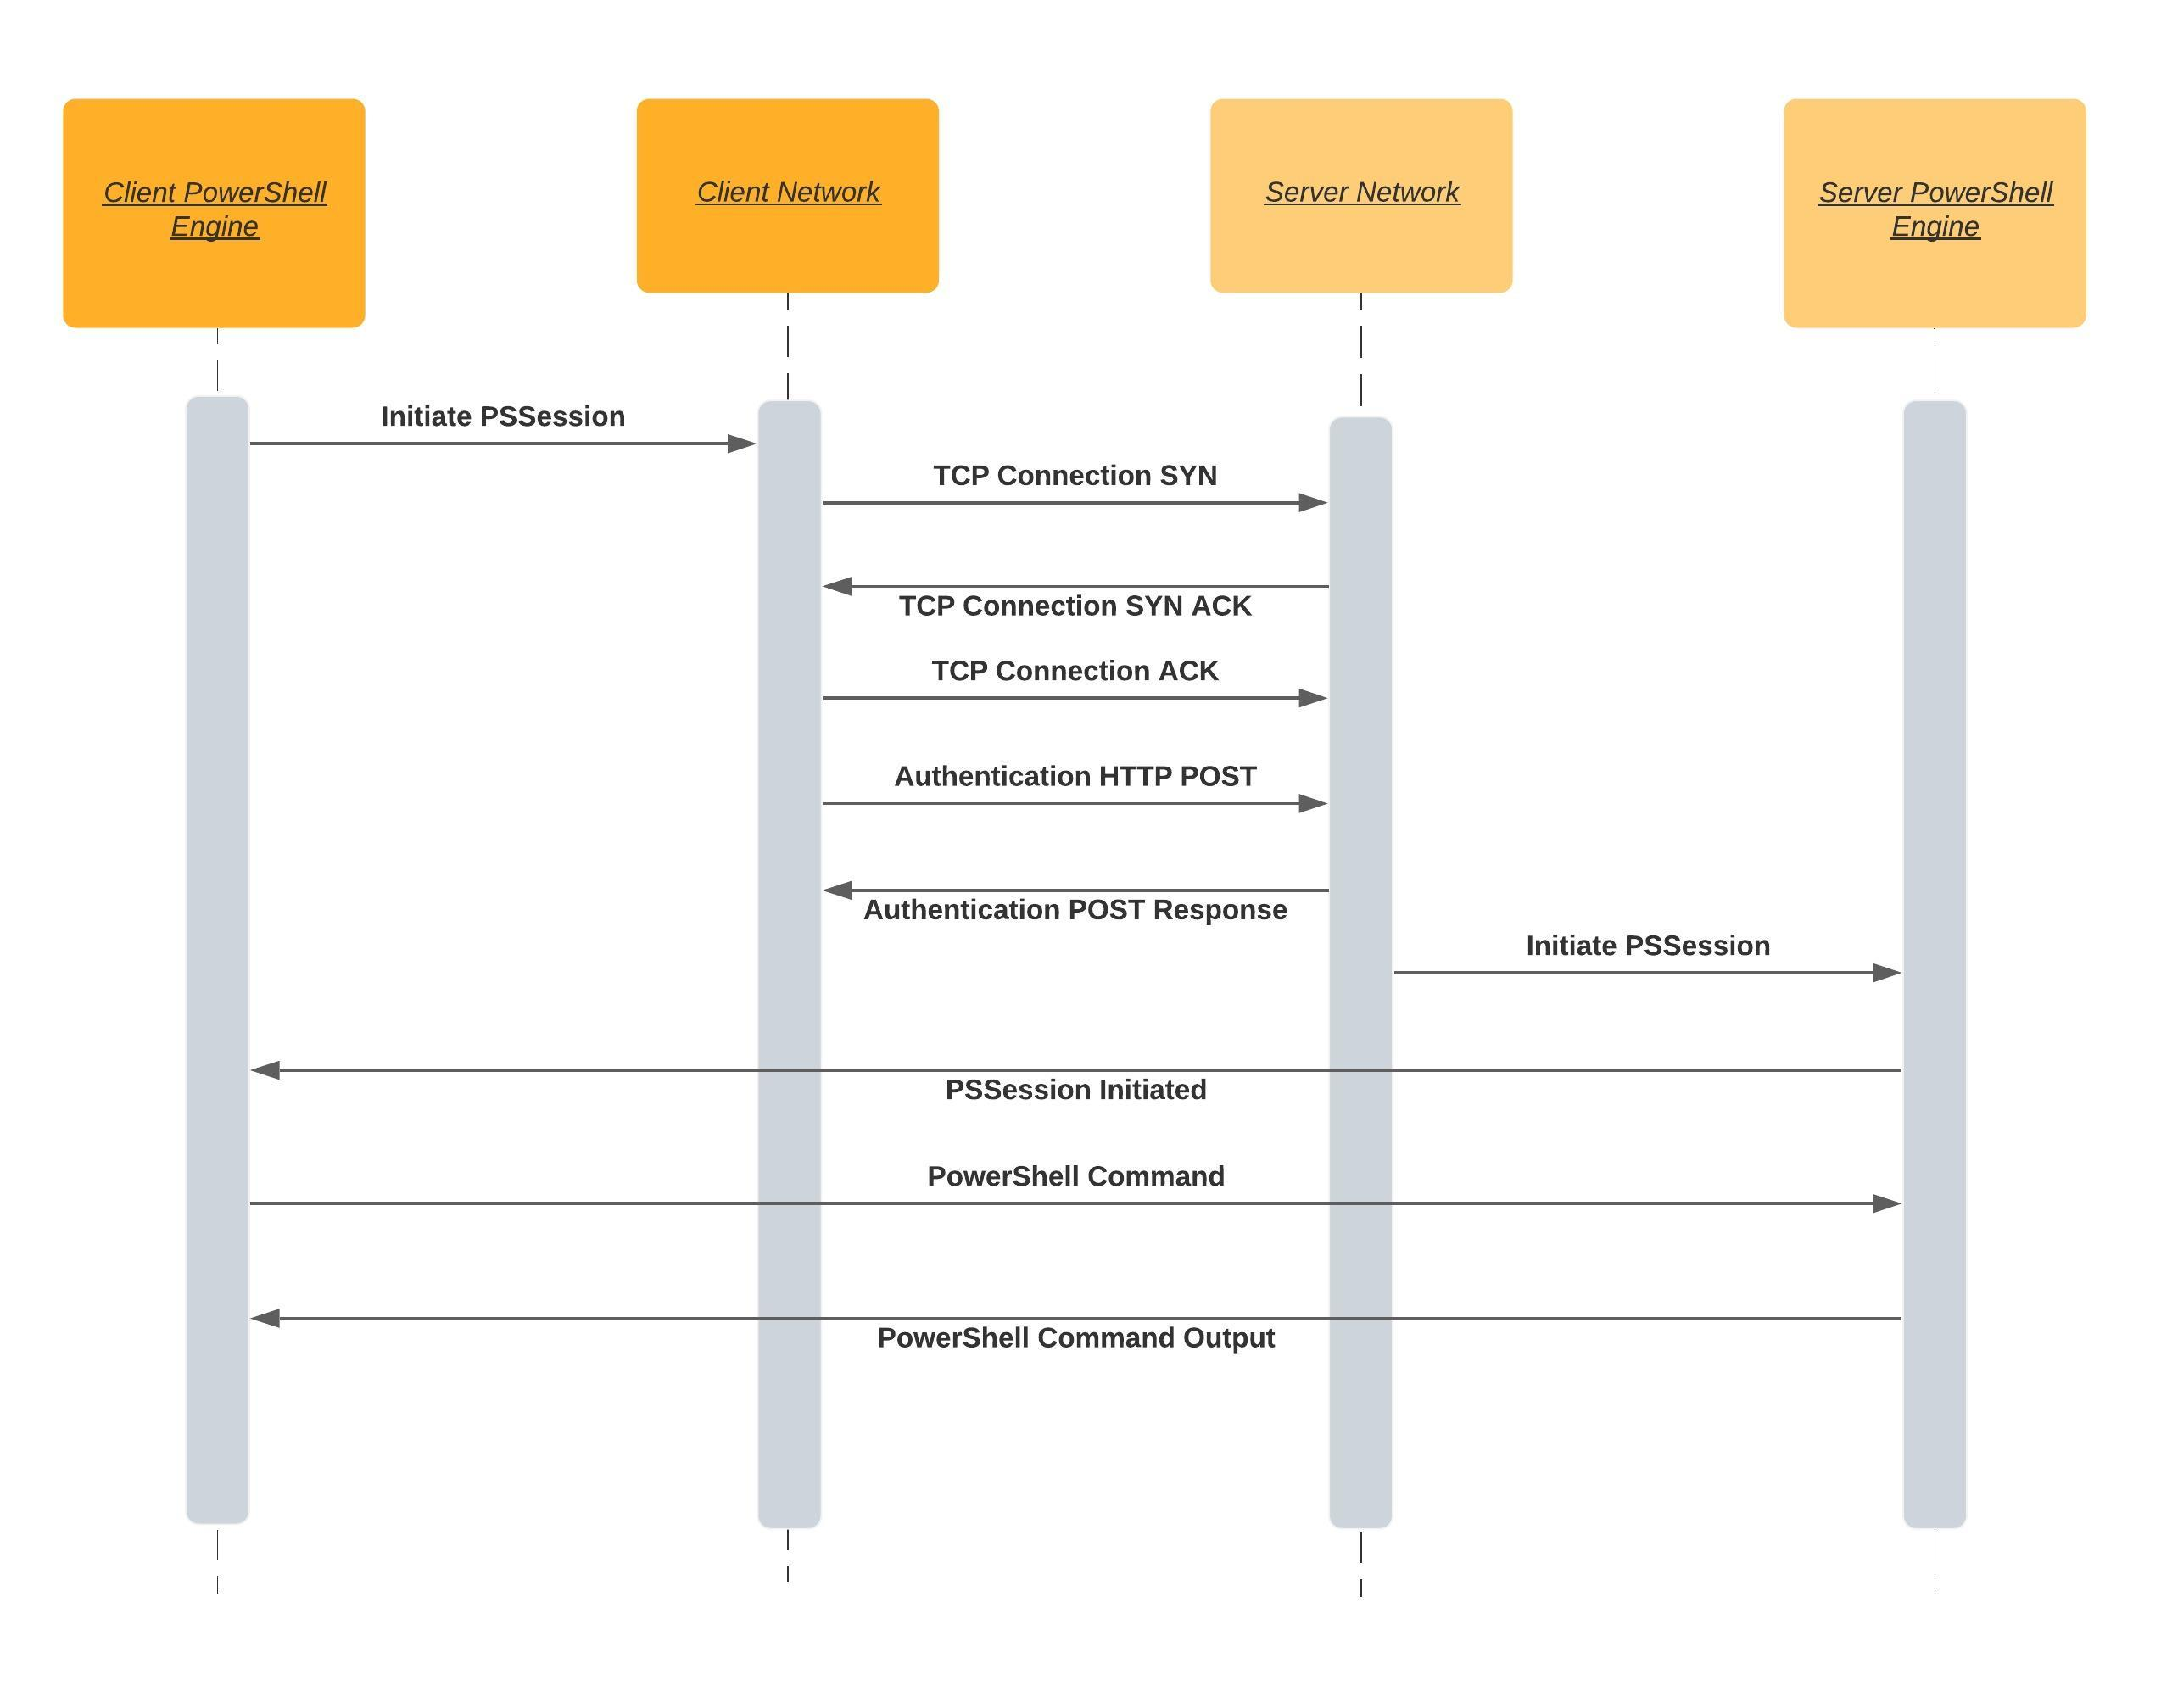
PowerShell the Gamechanger

Slide 16
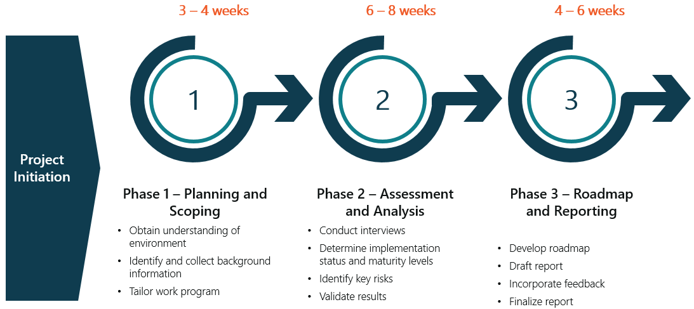
Approach
16

Slide 17


Phase 1 – Scope
Understanding of operating and business environment
Role technology plays and inherent risks
Critical systems
Sensitive information
Planning workshop(s)
Risk-tolerance, target state and business concerns
Confirm CMMI maturity levels
Category / subcategory ratings for comparison
Tailor assessment plan
Confirm in-scope NIST categories

Slide 18
Phase 1 – Interview Schedule
Topic | Proposed Time | Duration (hrs) | Stakeholders | Agenda
Understand Business and Role of Technology | September TBD | 1 hr | Security | Discuss operating and business environment and role of technology Background of business Different lines of business Overview of the IT department role and structure (e.g., size, key functions, centralization, outsourcing, vendors, cross functional, etc.)
Understand IT and Security Environment | September TBD | Multiple meetings TBD (1-2 hr meetings per point) | IT / Security | Obtain an understanding of IT / security environment, key applications, information sensitivity, use of cloud service providers and any specific regulatory security requirements IT environment – what are the key functions of the IT department, key technologies for network, infrastructure, cloud, applications, IAM, databases, endpoints (computers, mobile), service delivery, asset inventories (high level) Security team / program – what key functions are the security team doing, what does the overall program look like (e.g., strategy, risk management, governance, etc.) Key applications – which applications are the most critical, what’s their overall function, who manages them, where are they hosted, etc. Information sensitivity – what information is sensitive, where is sensitive information stored Service providers – what are the key services providers, what services are they providing, use of cloud technologies, any concerns with assessing service providers Security requirements – any contractual or regularly security requirements (e.g., privacy, PCI-DSS, etc.), who manages compliance
Planning Workshop(s) | September TBD | TBD | Include key business areas? (risk management, privacy, system owners) | Identify cyber security risk-tolerance, target state and business concerns from key business areas, information technology and cyber security stakeholders. Previous assessments, current projects and initiatives Target state and risk tolerance from different lines of business, business concerns

Slide 19
Phase 1 – Documentation Request
Security policies, procedures, standards, guidelines
Asset management, data classification and management, risk management, patch and vulnerability management, threat management, service provider risk management, identity and access management, privileged account management, network security, secure configuration, encryption standards, physical security, training and awareness, secure development, change management, backup and recovery, security logging and monitoring, incident management, disaster recovery
Security strategy / program artifacts
Organization charts (IT), including key service providers, if possible
Previous risk assessments (2019 Deloitte assessment, self assessments)
Overall network diagram(s)
List of key applications (criticality, function, management, technology, hosting)
List of sensitive information (overall view of where it is stored)
List of key service providers (basic service description info)
List of key overall IT assets (basic infrastructure, network, cloud, databases information)

Slide 20
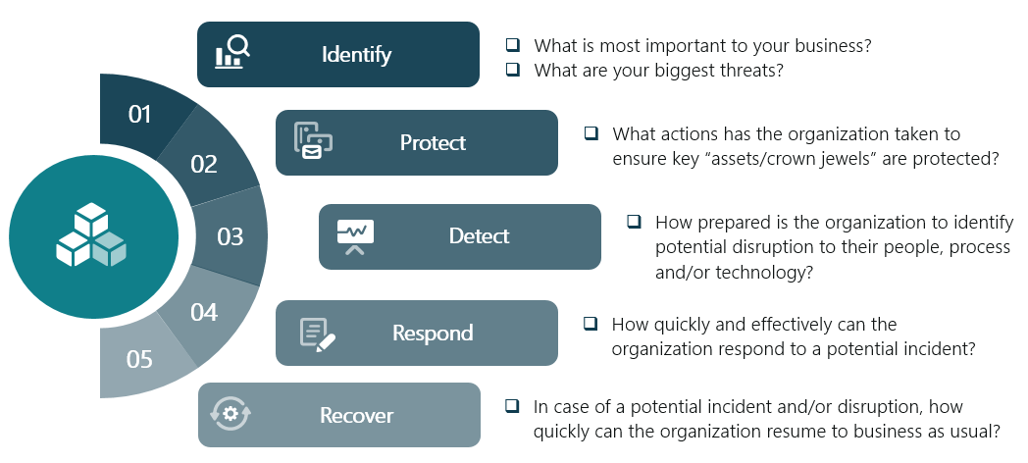
Phase 2 – Scope
Review NIST CSF
Identify, protect, detect, respond, recover (in scope domains – exclude ‘critical infrastructure’ specific)
Leverage CIS Controls where applicable
Assess implementation status
For controls not fully implemented, identify observations and assess residual risk
Assess the maturity rating
Using agreed maturity model
Compare against previous assessment results (confirm)

Slide 21
Phase 2 – Interview Schedule
Topic | Proposed Time | Duration (hrs) | Stakeholders | Agenda
Server and Storage Security | October / November TBD | 4 | TBD | Inventories, administrative access, data encryption, capacity management, backup management, secure configuration, patch management, anti malware protections ID.AM-1, PR.AC-7, PR.DS-1, PR.DS-2, PR.DS-4, PR.DS-6, PR.IP-1, PR.IP-4, DE.CM-4
Network Security | October / November TBD | 4 | TBD | Inventories, remote access, network segmentation, security filtering, administrative access, wireless security, data encryption, secure configuration, boundary defenses ID.AM-1, ID.AM-4, PR.AC-3, PR.AC-5, PR.AC-7, PR.DS-1, PR.DS-2, PR.IP-1
Computer and Mobile Security | October / November TBD | 3 | TBD | Inventories, data encryption, asset disposition, secure configuration, patch management, anti malware protections ID.AM-1, ID.AM-2, PR.DS-1, PR.DS-3, PR.IP-1, PR.PT-2, DE.CM-4
Security Operations | October / November TBD | 8 | TBD | Disaster recovery, vulnerability management, threat management, physical security, training and awareness, data encryption, data leak protection, change management, penetration testing, anti malware protections, incident management, security logging and monitoring ID.BE-4, ID.BE-5, ID.RA-1, ID.RA-2, ID.RA-3, ID.RA-4, ID.RA-5, ID.RA-6, PR.AC-2, PR.AC-6, PR.AT-1, PR.AT-2, PR.AT-3, PR.AT-4, PR.AT-5, PR.DS-5, PR.IP-3, PR.IP-5, PR.IP-7, PR.IP-9, PR.IP-10, PR.IP-12, PR.PT-1, DE, RS, RE
Security Management | October / November TBD | 6 | TBD | Data classification, security roles, policies, regulatory requirements, risk management, service provider risk management, data destruction, ID.AM-5, ID.AM-6, ID.BE-1, ID.BE-2, ID.BE-3, ID.GV-1, ID.GV-2, ID.GV-3, ID.GV-4, ID.RA-1, ID.RA-3, ID.RA-4, ID.RA-5, ID.RA-6, ID.RM-1, ID.RM-2, ID.RM-3, ID.SC-1, ID.SC-2, ID.SC-3, ID.SC-4, ID.SC-5, PR.IP-6
Update after phase 1

Slide 22
Phase 2 – Interview Schedule
Topic | Proposed Time | Duration (hrs) | Stakeholders | Agenda
Application Security | October / November TBD | 4 | TBD | Inventories, data encryption, environment separation, secure configuration, secure development, patch management ID.AM-2, ID.AM-3, ID.AM-4, ID.AM-5, PR.DS-2, PR.DS-7, PR.IP-1, PR.IP-2
Database Security | October / November TBD | 4 | TBD | Inventories, data encryption, capacity management, environment separation, secure configuration, secure development, patch management ID.AM-1, ID.AM-3, ID.AM-4, PR.DS-1, PR.DS-4, PR.DS-7, PR.IP-1, PR.IP-2
Cloud Security | October / November TBD | 4 | TBD | Inventories, data encryption, capacity management, secure configuration ID.AM-4, PR.DS-1, PR.DS-2, PR.DS-4, PR.IP-1
Service Desk | October / November TBD | 3 | TBD | Access management, authentication, change management PR.AC-1, PR.AC-4, PR.AC-7, PR.IP-3, PR.IP-11
Update after phase 1

Slide 23
Phase 2 – Documentation Request
Detailed asset inventory (server, network, infrastructure, storage, computer, mobile, application, database)
Data flows (applications, databases, service providers)
Network diagrams (detailed)
Architecture diagrams (for key applications / systems / cloud)
Secure configuration standards
Business continuity plan
IT disaster recovery plan
Incident response plan
Vulnerability assessment dashboards (screenshot)
Penetration test reports
Update after phase 1. Note: additional documentation typically requested during interviews

Slide 24
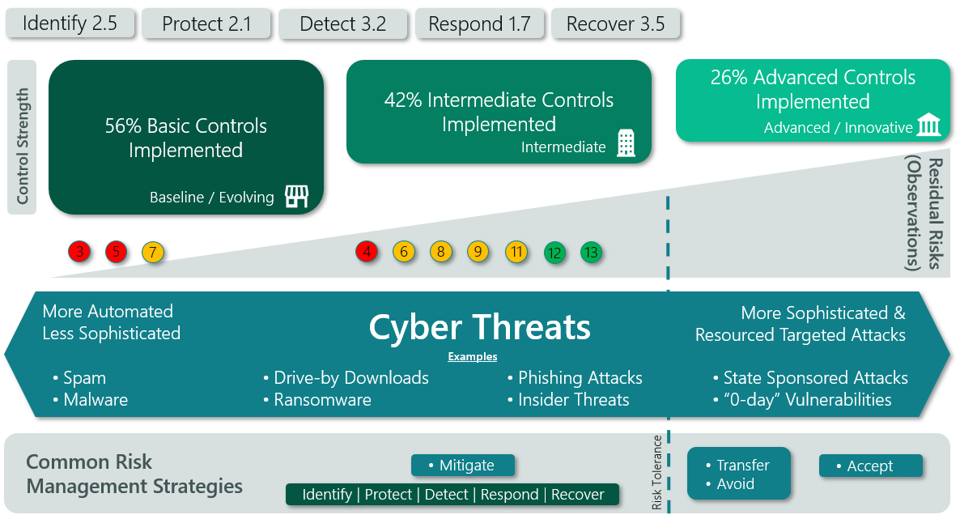
Example Dashboard
Maturity and Threat Dashboard

Slide 25
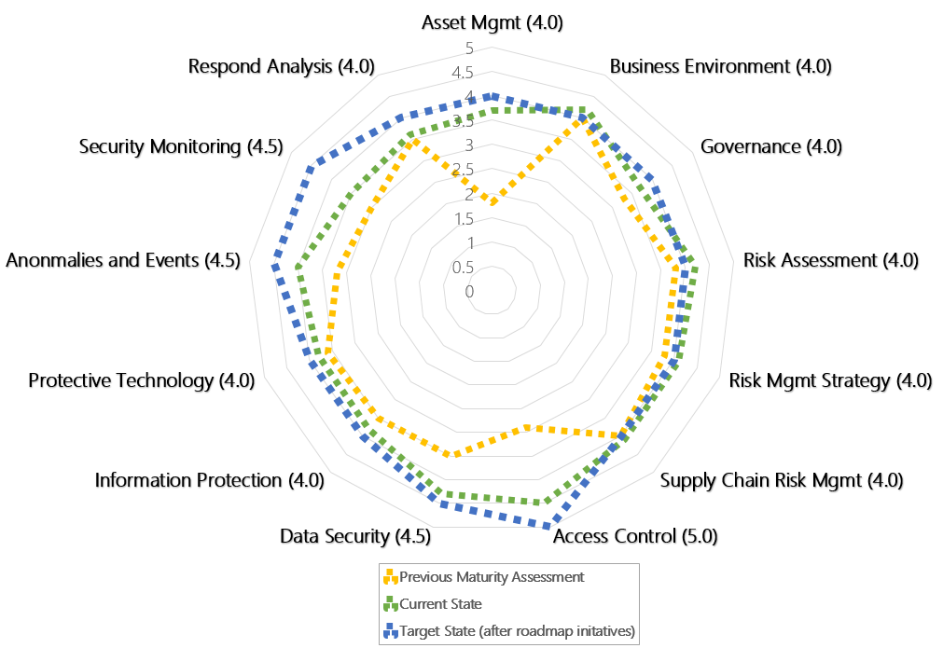
Example Dashboard
Maturity Comparison

Slide 26
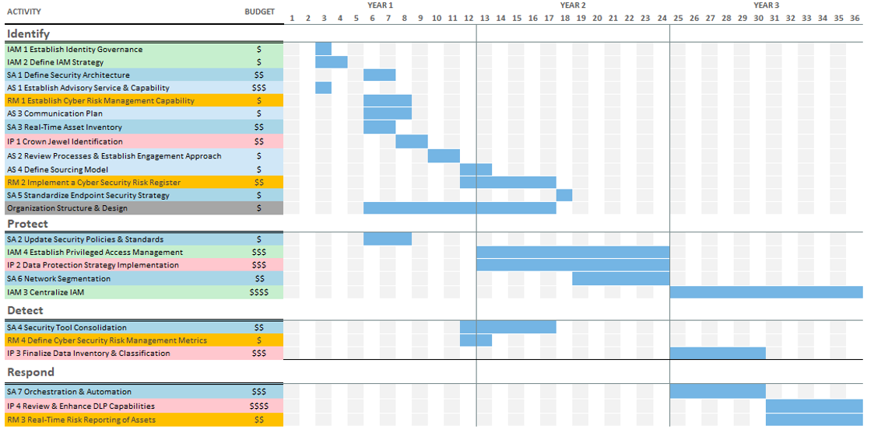
Phase 3 – Scope
Share observations
Develop roadmap
Based on observations to realize target state
Define investments, timing, actions
Review roadmap
Draft report
Finalize report

Slide 27
Phase 3 – Interview Schedule
Topic | Proposed Time | Duration (hrs) | Stakeholders | Agenda
Discuss Observations | December TBD | 2 | Security | Share observations in advance, validate and discuss. Confirm target state.
Discuss Roadmap | December TBD | 2 | Security | Present initial roadmap and gather feedback.
Discuss Report | December TBD | 1 | Security | Discuss and gather final feedback on report.

Slide 28
High Level Timeline
Sep-6 | Sep-13 | Sep-20 | Sep-27 | Oct-4 | Oct-11 | Oct-18 | Oct-25 | Nov-1 | Nov-8 | Nov-15 | Nov-22 | Nov-29 | Dec-6 | Dec-13 | Dec-20
Kickoff
Phase 1: Planning & Scoping
Phase 2: Assessment & Analysis
Phase 3: Roadmap & Report
Project Management

Slide 29
Proposed High Level Schedule
Phase | Activity | Target Deadline Date
1. Planning & Scoping | Documentation collection | Week of Sept 27th
 | Understanding business and IT environments | Week of Sept 27th
 | Planning workshops and tailor assessment plan | Week of Oct 4th
2. Assessment & Analysis | Review documentation | Week of Oct 11th
 | Conduct interviews | Week of Nov 1st
 | Review controls, analyse, develop observations | Week of Nov 8th
 | Maturity ratings / threat modeling / validate | Week of Nov 15th
3. Roadmap & Report | Develop roadmap | Week of Nov 29th
 | Review with stakeholders and update report | Week of Dec 13th
 | Final report delivery | Week of Dec 20th

Slide 30



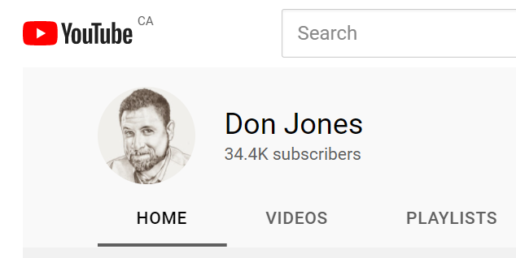
Resources

Slide 31

Thanks!!!
Q&A
@browinfosecguy

Slide 32
Maturity Model
ISACA / CMMI Institute
Maturity Levels
1. Performed | General personnel capabilities may be performed by an individual, but are not well defined. General process capabilities may be performed by an individual, but are not well defined. General technical mechanisms are in place and may be used by an individual.
2. Managed | Personnel capabilities achieved consistently within subsets of the organization, but inconsistent across the entire organization. Adequate procedures documented within a subset of the organization. Technical mechanisms are formally identified and defined by a subset of the organization; technical requirements in place.
3. Defined | Roles and responsibilities are identified, assigned, and trained across the organization. Organizational policies and procedures are defined and standardized. Policies and procedures support the organizational strategy. Purpose and intent is defined (right technology, adequately deployed); Proper technology is implemented in each subset of the organization.
4. Quantitatively Managed | Achievement and performance of personnel practices are predicted, measured, and evaluated. Policy compliance is measured and enforced Procedures are monitored for effectiveness. Effectiveness of technical mechanisms are predicted, measured, and evaluated.
5. Optimized | Proactive performance improvement and resourcing based on organizational changes and lessons learned (internal & external). Policies and procedures are updated based on organizational changes and lessons learned (internal & external) are captured. Technical mechanisms are proactively improved based on organizational changes and lessons learned (internal & external).

Slide 33
Maturity Model
FFIEC – Federal Financial Institutions Examination Council – Cyber Assessment Tool
Maturity Levels
1. Baseline | Baseline maturity is characterized by minimum expectations required by law and regulations or recommended in supervisory guidance. This level includes compliance-driven objectives. Management has reviewed and evaluated guidance.
2. Evolving | Evolving maturity is characterized by additional formality of documented procedures and policies that are not already required. Risk-driven objectives are in place. Accountability for cybersecurity is formally assigned and broadened beyond protection of customer information to incorporate information assets and systems.
3. Intermediate | Intermediate maturity is characterized by detailed, formal processes. Controls are validated and consistent. Risk-management practices and analysis are integrated into business strategies.
4. Advanced | Advanced maturity is characterized by cybersecurity practices and analytics that are integrated across lines of business. Majority of risk-management processes are automated and include continuous process improvement. Accountability for risk decisions by frontline businesses is formally assigned.
5. Innovative | Innovative maturity is characterized by driving innovation in people, processes, and technology for the institution and the industry to manage cyber risks. This may entail developing new controls, new tools, or creating new information-sharing groups. Real-time, predictive analytics are tied to automated responses.

